Slide 1
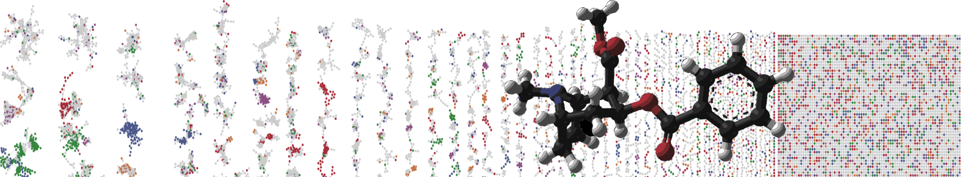


GNPS Classic Molecular Networking Job Submission
HANDS ON
ENTER AUTHORS HERE
University of California - San Diego

Slide 2
Objectives and Data
Create GNPS Account
Find Molecular Networking Workflow
Select Public Data to Analyze
Launch GNPS Molecular Networking Job
GNPS Drug Metabolism Demo Data - MSV000081098

Slide 3
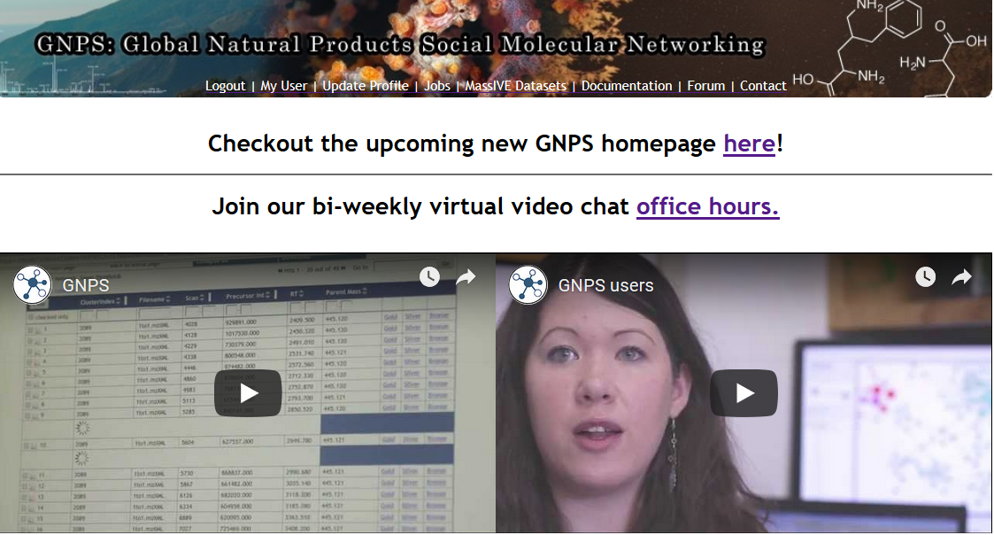
Go to GNPS (gnps.ucsd.edu)

Slide 4
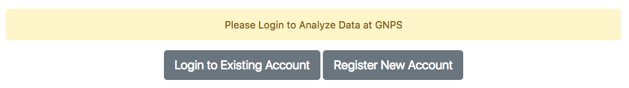
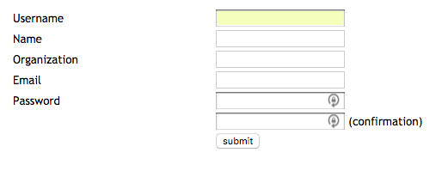
Create an Account

Slide 5
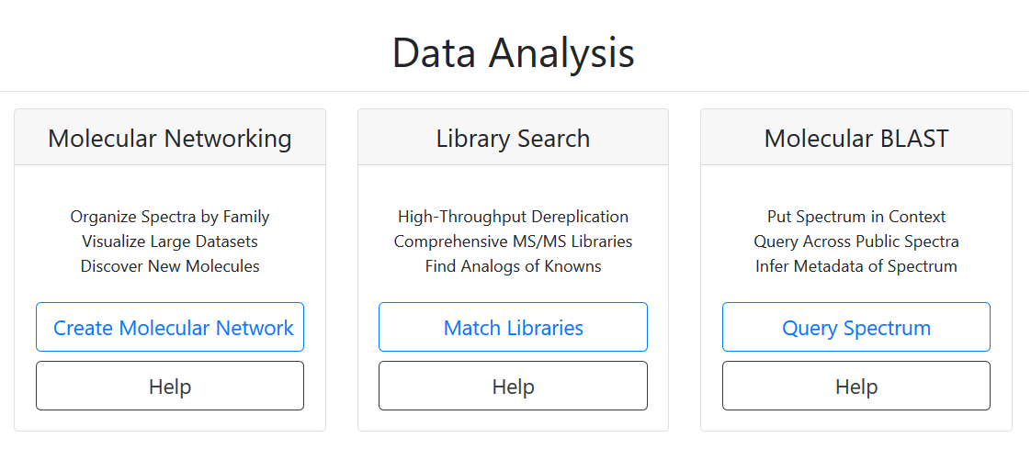

Slide 6
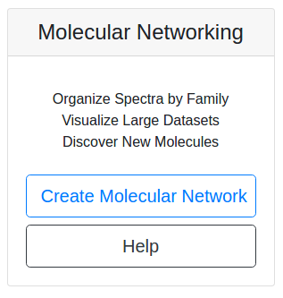
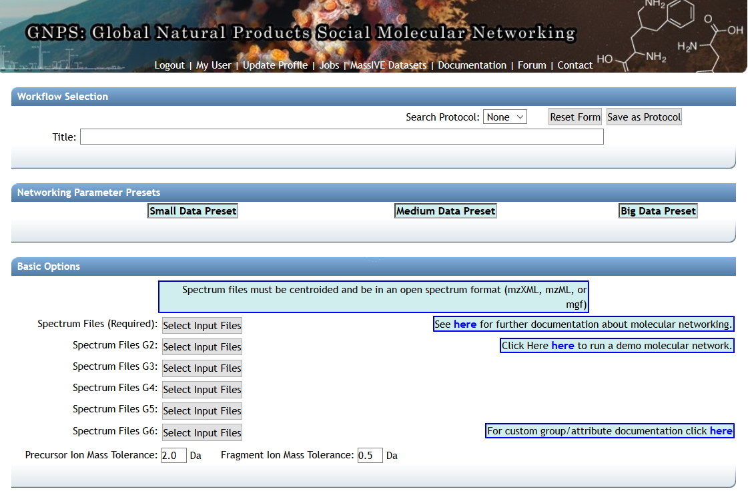

Slide 7
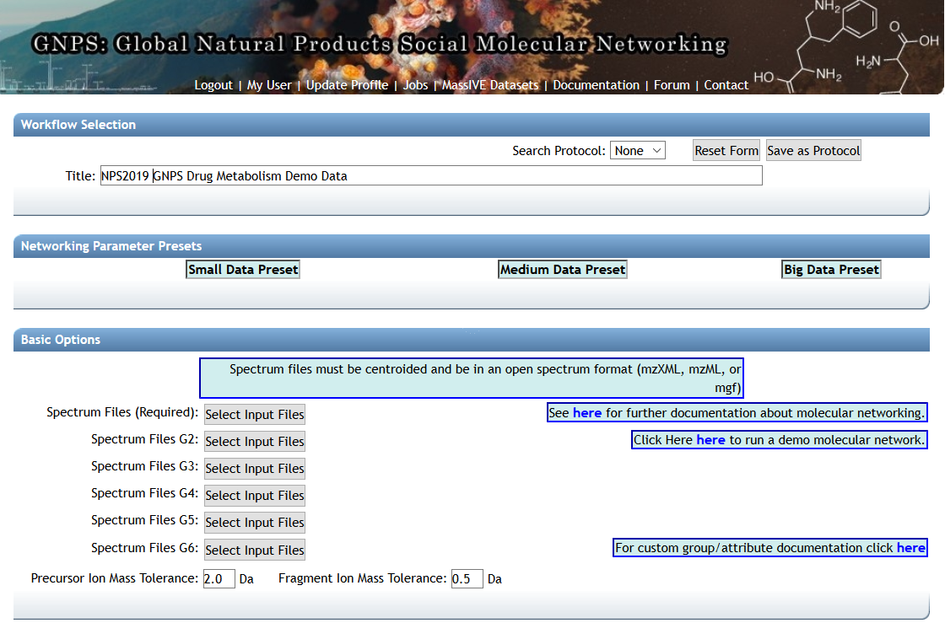
Name the GNPS job and select the Spectrum files

Slide 8
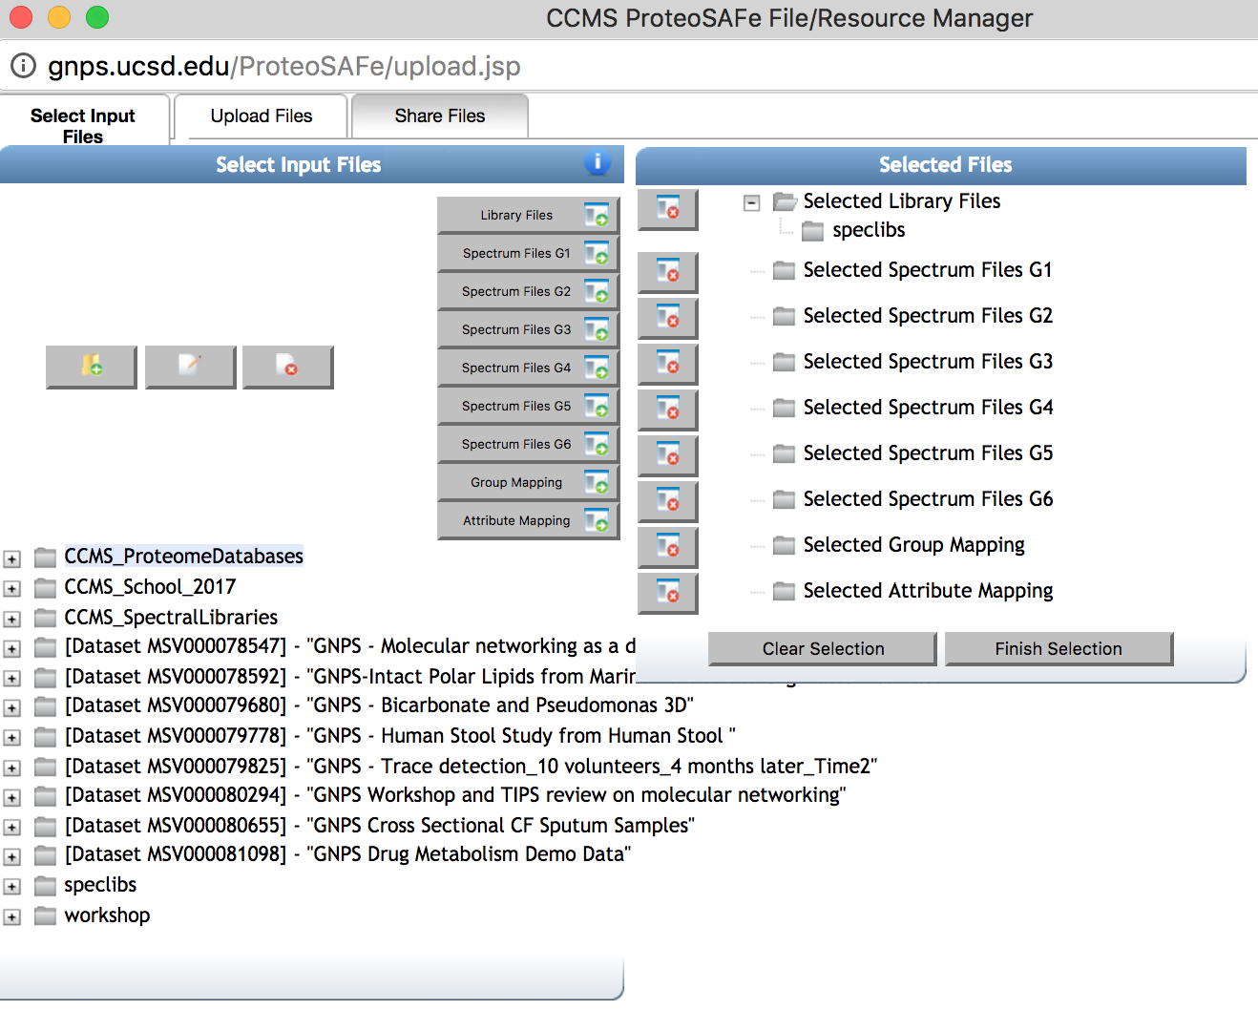

Slide 9
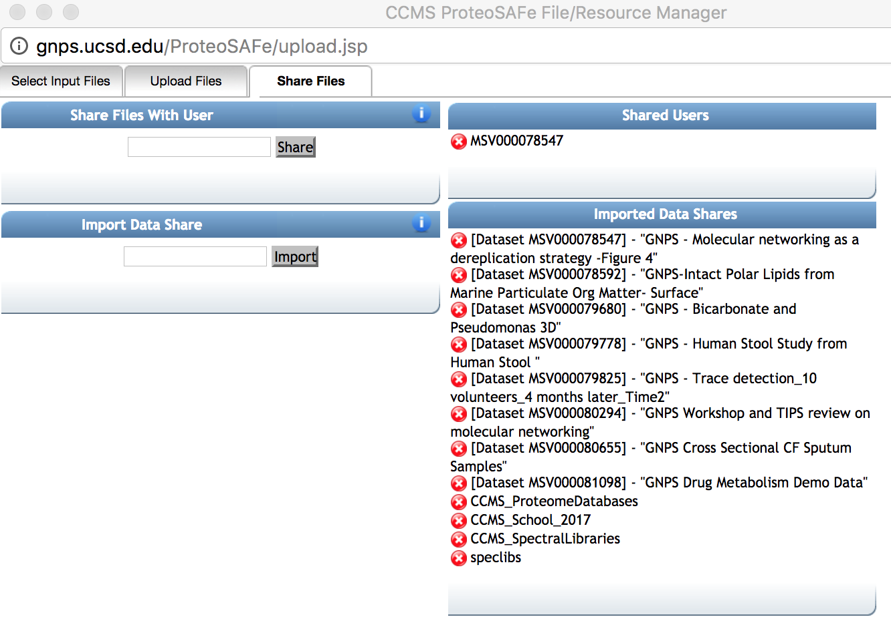
MSV000081098
MSV000081098

Slide 10
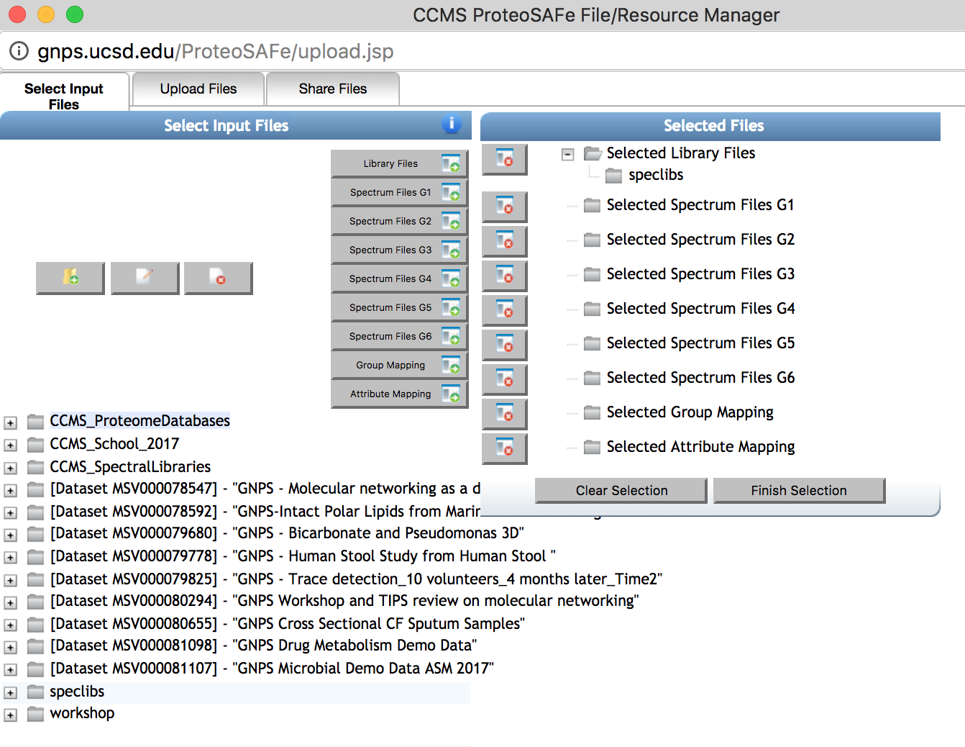
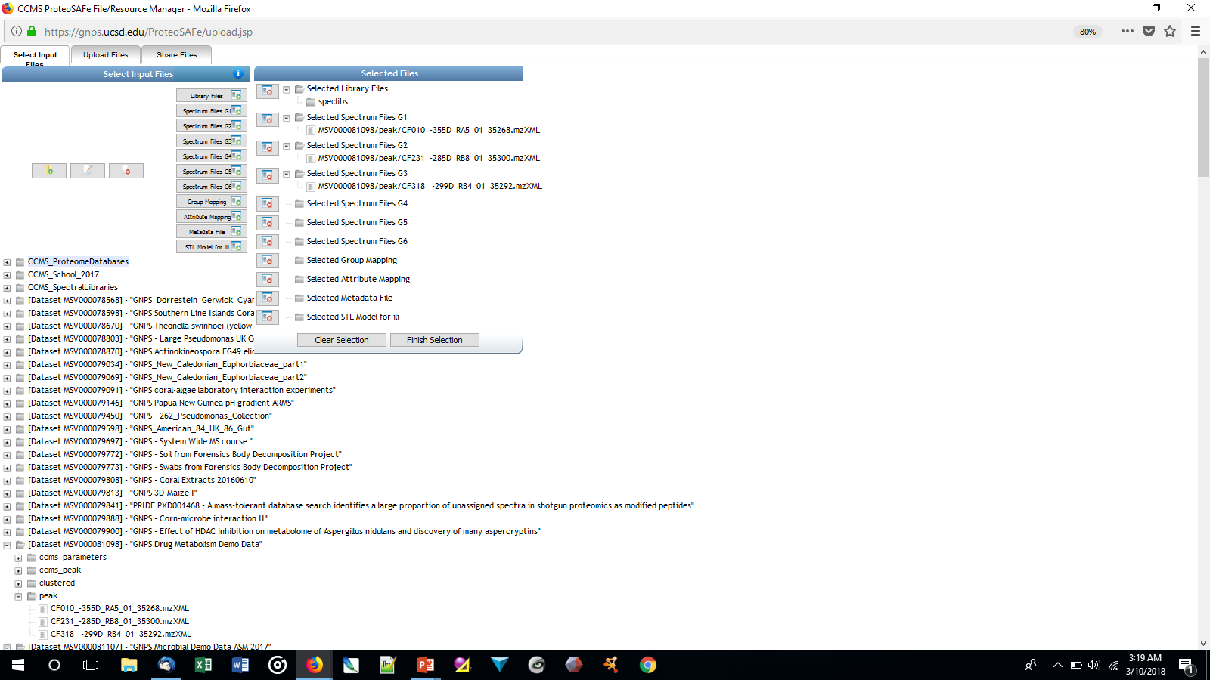

Slide 11
Spectrum Files G1
Spectrum Files G2
Spectrum Files G3
Notes:
These are three patients that have been taking antibiotic drugs.

Slide 12
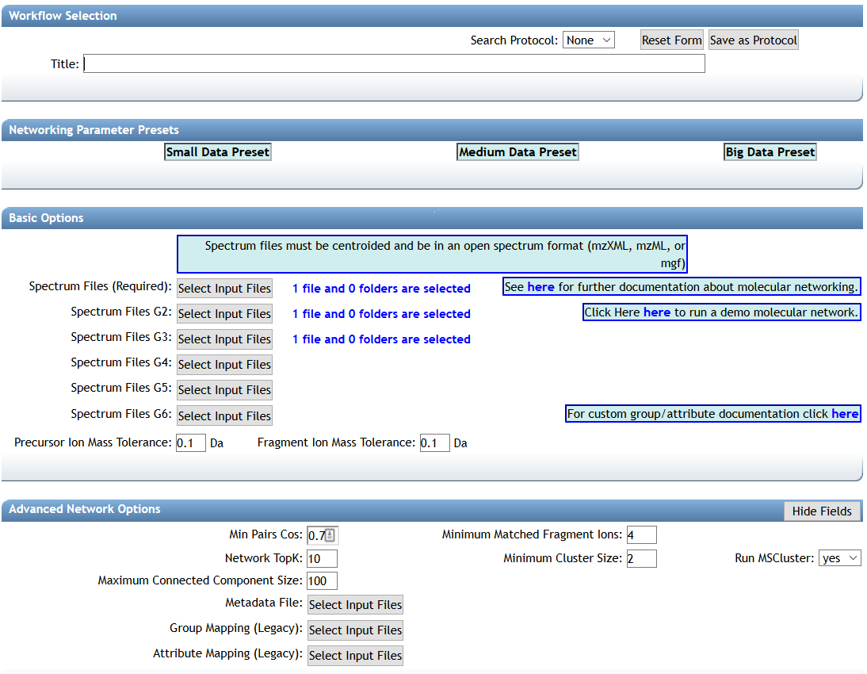
NPS2019 GNPS Drug Metabolism Demo Data

Slide 13
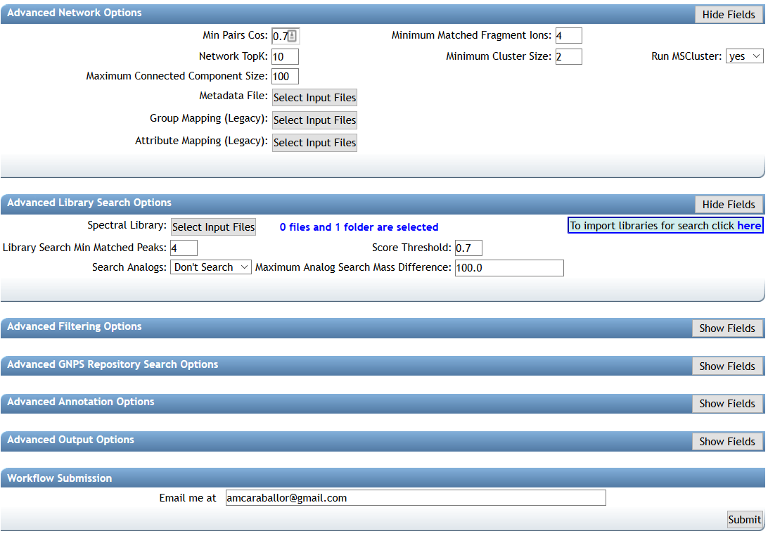
~13min – 34 min
Link to the GNPS job NPS2019 GNPS Drug Metabolism Demo Data
Notes:
5-10min to see if everyone got it?

Slide 14
Questions, Problems or Bugs?
Documentation: https://ccms-ucsd.github.io/GNPSDocumentation/
Forum: https://groups.google.com/forum/#!forum/molecular_networking_bug_reports
PRESENTER NAMES AND EMAILS HERE

